Slide 1

ERASMUS programme 2025/26
Procedure and Formalities
International Office
Stand: November 2025

Slide 2

ERASMUS+
Advantages of the programme:
No tuition fees abroad
Documentation and recognition of achievements
Contact person at the home and host university
Mobility grant (by country group)
4

Slide 3
ERASMUS+
Administration of the programme by the International Office (IO) of Trier University of Applied Sciences (TUAS)
Contact persons at the main campus: Christoph Lex, Iris Musch
Further information: https://www.hochschule- trier.de/international/outgoings/studierende/erasmus-studium-oder- praktikum/

Slide 4
FINANCIAL SUPPORT
The Erasmus grant will only provide you with a subsidy for additional costs that arise during your stay abroad
The amount of the grant depends on the country group, the
total funds available and the duration of your stay abroad.
→ Additional funding will be necessary, e.g. DAAD, Auslands- BAföG, HAW

Slide 5
FINANCIAL SUPPORT
Country groups (defined by the EU on the basis of the cost of living, expected payment)
Country group 1: 600 Euro/month
Austria, Belgium, Denmark, Finland, France, Ireland, Iceland, Italy, Liechtenstein, Luxembourg, Netherlands, Norway, Sweden
Country group 2: 540 Euro/month
Cyprus, Czech Republic, Estonia, Greece, Latvia, Malta, Portugal, Slovakia, Slovenia, Spain
Country group 3: 540 Euro/month
Bulgaria, Croatia, Lithuania, North Macedonia, Poland, Romania, Serbia, Türkiye, Hungary

Slide 6
REQUIREMENTS - Overview
BEFORE
Required documents:
The original Grant Agreement (declaration of acceptance)
Payment Order as a PDf file filled out on the computer („Annahme-und Datenschutzerklärung“ – Please submit the original with your signature to the IO)
(Online) Learning Agreement

Slide 7
REQUIREMENTS
On arrival
Required documents:
Confirmation of Study Period – First Day of Study (alternatively the confirmation of enrolment from the university)
Confirmation of Enrolment at Trier University of Applied Sciences
Before leaving
Confirmation of Study Period – Last Day of Study

Slide 8
REQUIREMENTS
AFTER
Mandatory:
Submission of an online report
Transcript of Records (as a copy)

Slide 9
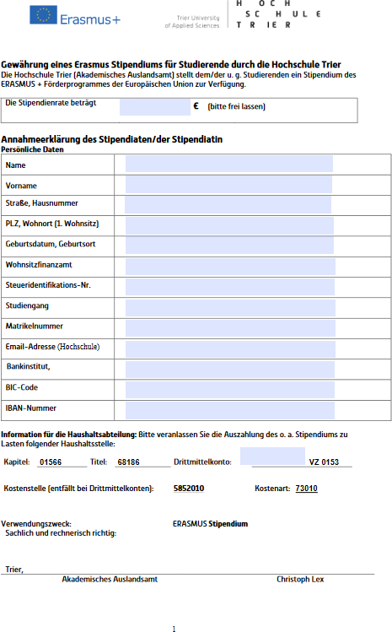
BEFORE
Payment Order (Annahmeerklärung)
Please enter:
Personal details
Tax number
Department at TUAS
Bank account details
submit the original to the IO
before the start of the stay abroad

Slide 10
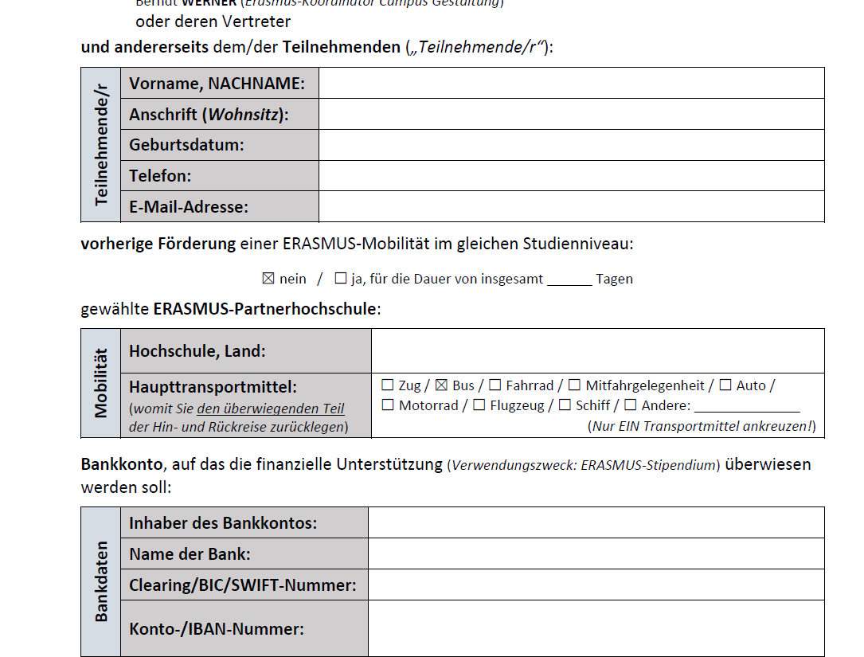
BEFORE
Grant Agreement
please enter:
Personal details (please give your TUAS Email address)
Your host university
Your means of travel
bank account details

Slide 11

BEFORE
ONLINE LEARNING AGREEMENT
Learning agreement to be drawn up before the start of the stay
If online OLA not possible, please use pdf version.
Goal: Recognition of achievements acquired abroad

Slide 12
BEFORE
ONLINE LEARNING AGREEMENT
Must be agreed with the department (J. Rock)
Must be signed by the student, the home university and the host university
OLA: all parties need to have an up-to-date copy.
PDF: Original with student, send copy/scan to Int. Office and department.

Slide 13
BEFORE
APPLICATION DEADLINE
Hand in your
Grant Agreement
Payment Order
(Online Learning Agreement)
by 30th January 2026!

Slide 14
WHILE ABROAD
ONLINE LEARNING AGREEMENT
Changes during the stay must be noted and again signed by all parties (student, home and host university) in the (online) learning agreement.
Send a copy/scan of the PDF to Int. Office.

Slide 15
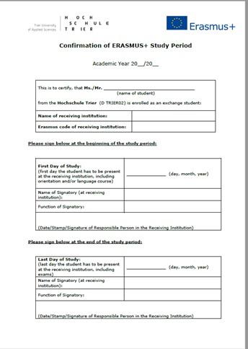
WHILE ABROAD
CONFIRMATION OF STAY
Have it signed after arrival at the host university
Absolutely necessary for payment of the grant!
Start and end dates are important for the amount of funding (exact daily settlement).

Slide 16
AFTER
ONLINE REPORT
Compulsory participation for the evaluation of the programme
Access link will be sent automatically by e-mail from the EU a few days after the end of the stay abroad.
Please ensure that you can be contacted by (university) e-mail!
no later than 10 days after return (Participants who fail to complete and submit the online participant report may be required to partially or fully reimburse the financial support received)

Slide 17
AFTER
TRANSCRIPT OF RECORDS
Certificate / transcript of records from the host university
Please send a scanned copy to the IO!

Slide 18
ERASMUS+ APP
The Erasmus+ app provides you with useful information and functions before, during and after your stay abroad
You can find more information and download the app here: https://erasmusapp.eu

Slide 19
INSURANCE COVERAGE
The ERASMUS scholarship does not include any insurance cover.
ERASMUS scholarship holders declare in their declaration of acceptance that they will personally ensure that they have adequate insurance cover for the duration of their stay abroad.

Slide 20
INSURANCE COVERAGE
We recommend taking out the following insurance policies:
Health insurance and supplementary international health insurance with repatriation cover
Liability insurance with cover abroad
Accident insurance with cover abroad
Please enquire about this with the insurance companies you know!

Slide 21
INSURANCE COVERAGE
The DAAD further offers participation in a group insurance programme for health, accident and liability insurance.
DAAD Insurance Centre: https://www.daad.de/versicherung/de/

Slide 22
HEALTH INSURANCE
As a member of a statutory health insurance scheme, you can use the European Health Insurance Card (EHIC) to claim benefits abroad, depending on the applicable social security legislation in the country in question.
Before your departure, contact your health insurance company to find out to what extent this agreement applies to your host country and apply for the necessary forms or the card.

Slide 23
HEALTH INSURANCE
Private health insurance companies generally do not have Europe-wide social security agreements, so you may need additional insurance cover for your stay abroad!

Slide 24
In case you would like to go over it again:
You can find all the information from this presentation and much more on the website of the International Office:
https://www.hochschule-trier.de/international/wege-ins-ausland/studierende/erasmus-studium-oder-praktikum
Detailed information about your rights and obligations in the ERASMUS+ Student Charter:
https://www.hochschule-trier.de/fileadmin/Hochschule/Einrichtungen/Auslandsamt/Dateien/International_Office/ERASMUS/Erasmus_Studierendencharta.pdf

Slide 25
ANY QUESTIONS?
The International Office wishes you all the best during your time abroad and is always available to answer any further questions you may have!
Christoph Lex, lex@hochschule-trier.de, G108 Iris Musch, i.musch@hochschule-trier.de, X5

